Slide 1
Blood Supply Chain Management System Using BlockChain
Group Members: Moiz Ahmed (P18-0107) Umair Maratab (P18-0045) Aamir Khan (P18-0121) Supervisor: M. Taimoor Khan

Slide 2
Introduction
Blood management is essential for Humans life
Trustworthy
Mismanagement leads to blood wastage
Blockchain brings blood Banks, Donors,Blood collection, Testing centers, Hospital and Patient at one platform

Slide 3
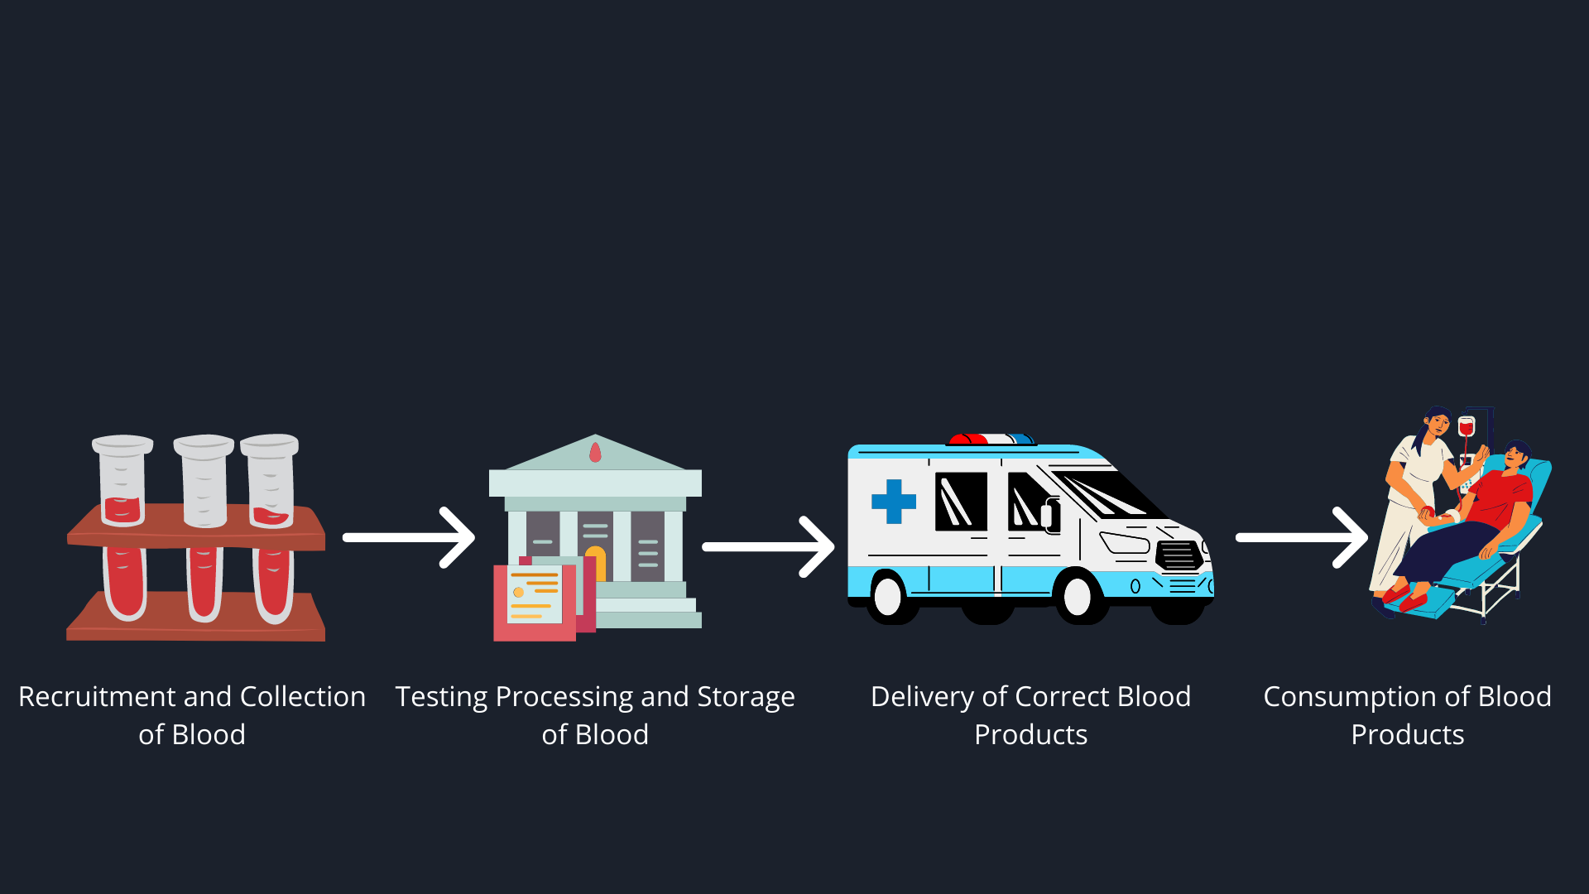
Blood Supply-Chain Process

Slide 4
Objective
Gap in Supply and Demand
Security is main issue in such systems
Maintain Records of
Blood donors
Blood Recipients
Blood stocks

Slide 5
Scope
Blood management is essential for Humans life
Trustworthy
Mismanagement leads to blood wastage
Blockchain brings blood Banks, Donors,Blood collection, Testing centers, Hospital and Patient at one platform

Slide 6
Problem Statement
Centralized System
Security Issue
Blood wasted Due to expiry
No Traceability

Slide 7
Solution
Decentralized System
Distributed Systems
Traceability
Very Secure

Slide 8
Objectives
To ensure that the patient get the safe blood
Trustworthy system
Storing Data from Blood donor to recipient

Slide 9
Goals
FYP-1
Will do backend coding for our Ethereum dApp.
FYP-2
Will do front-end coding and connecting our backend to blockchain network

Slide 10
End Product
Ethereum Blockchain (DApp) with full working user interface

Slide 11
References
uFeng Tian. “An agri-food supply chain traceability system for China based on RFID & blockchain technology”. In: Service Systems and Service Management (ICSSSM), 13th International Conference on. IEEE, pp. 1–6, (2016).
uA. Jabbarzadeh, F. Behnam and S. Stefan. “Dynamic supply chain network design for the supply of blood in disasters: A robust model with real-world application”. In: Transportation Research Part E: Logistics and Transportation Review, vol. 70, pp. 225-244, (2014).

Slide 12
Thanks!

